Slide 1
Wind Resources

Slide 2
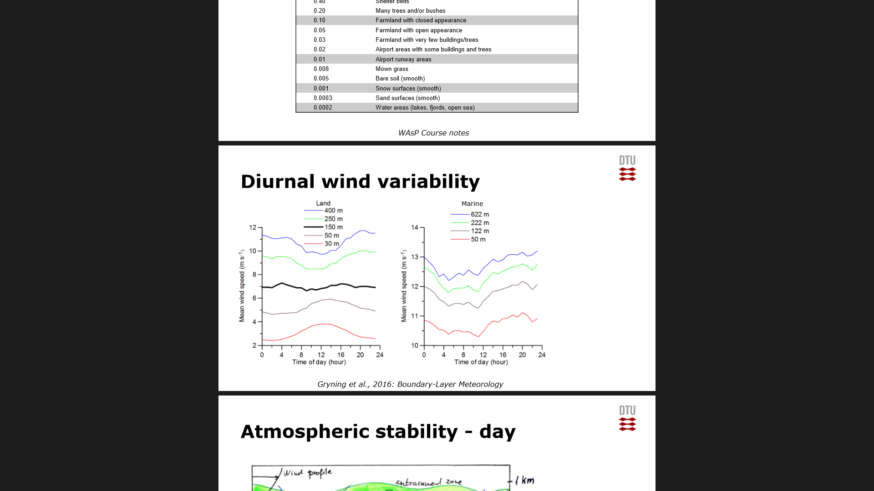
Winds are different during day & night

Slide 3
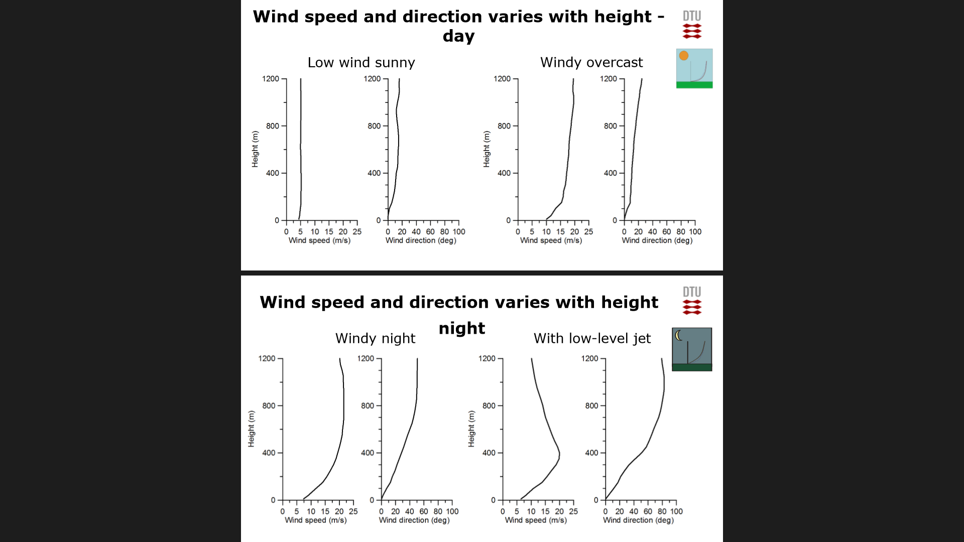

Slide 4
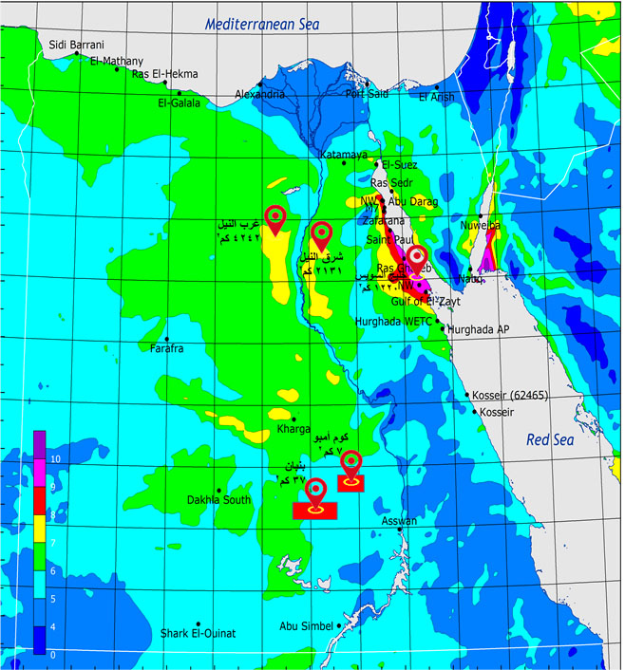

Slide 5
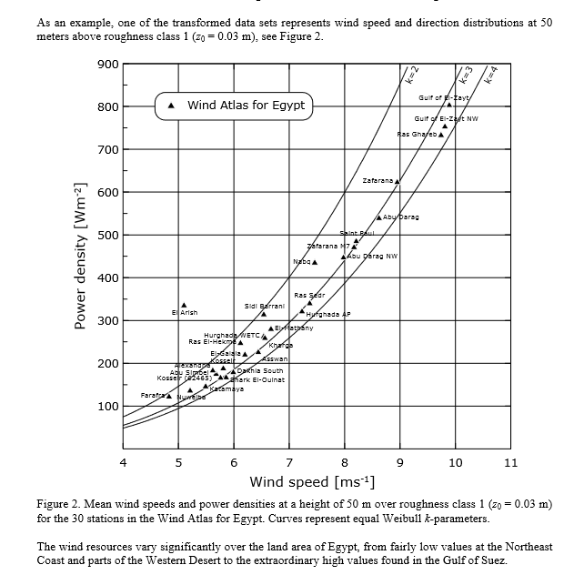

Slide 6
Wind resources assessment
How much energy can be extracted from wind by use of wind turbine.

Slide 7
WAsP
WAsP :Wind Atlas Analysis and Application Program.
WAsP is used for:
Wind farm production
Wind farm efficiency
Micro-siting of wind turbines
Power production calculations
Wind resource mapping
Wind climate estimation
Wind atlas generation
Wind data analysis

